Slide 1
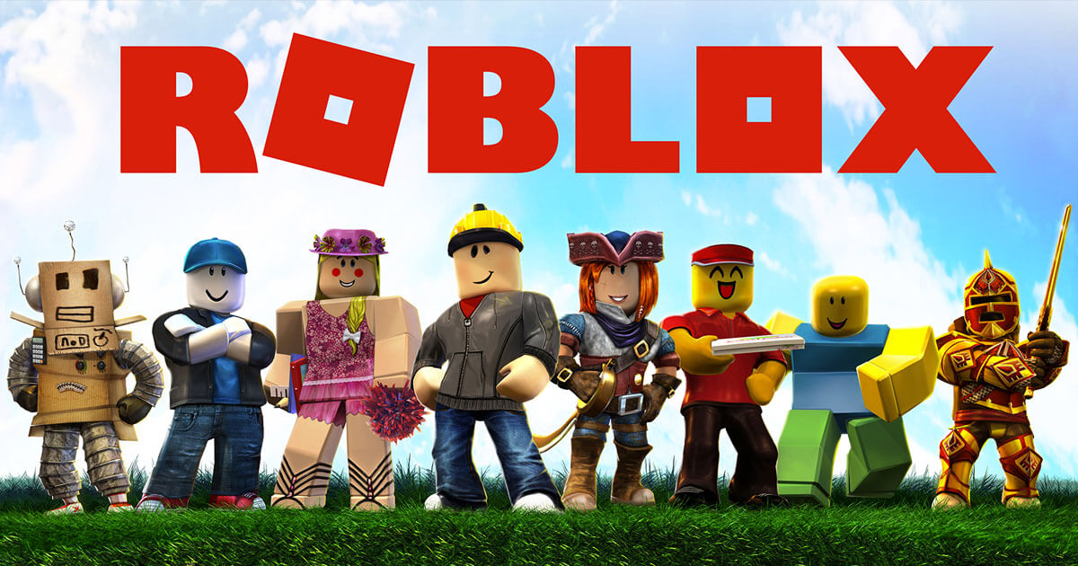
Term Project
Week

Slide 2
COURSE TIMELINE
Term Project
Term Project
Programming Projects with Lua
Roblox Studio Basics
Constraints Pt 1
Constraints Pt 2
Intro to Lua
Parameters
Loops & Conditionals
Functions
W1
W2
W3
W4
W5
W6
W7
W8

Slide 3

Edmodo
Resource Hub
Slides
Learning Material
Exercises/ Assignments / Quizzes
Tutorial Videos
WHEN TO CHECK
FRIDAY AFTERNOON EVERY WEEK
Communication
Directly message teachers
Post Questions
Post Screenshots of your work

Slide 4
TODAY’S LESSON
1
REVIEW: GAME
2
CLASS PROJECT: RACING GAME

Slide 5

REVIEW
Notes:
https://codecombat.com/students?_cc=BackPlateTurnhttps://codecombat.com/students?_cc=BackPlateTurn

Slide 6
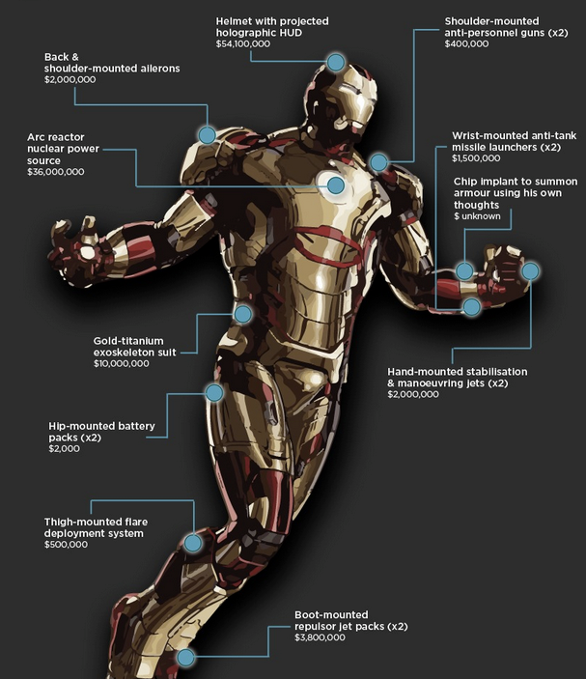
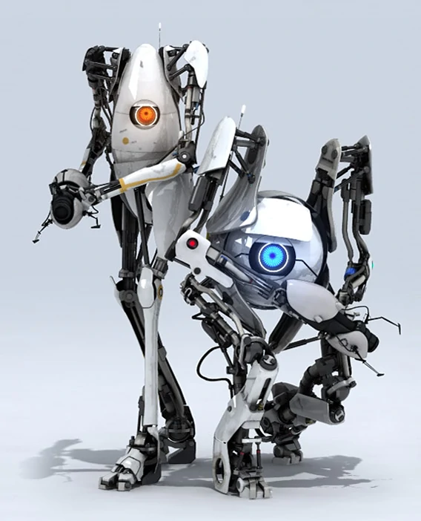
BUILDING THINGS WITH CONSTRAINTS
When we start looking at building more sophisticated games and machines, things can get complicated really fast.
In the real world, machines aren’t just made up of one constraint.
Often, we need to use multiple constraints (sometimes even hundreds) together to get machines to do stuff.

Slide 7
GAME DEVELOPMENT PROCESS
Here’s how game developers think. . .
IDEATE
DEVELOPMENT
LAUNCH
Figure out what you want to build and any cool features you might want to add.
Start building it using Roblox Studios. One step at a time.
Once your game is ready, publish and share it live onto Roblox!
DESIGN
TEST
Plan out what parts you need, the types of constraints and how it all works together. Then try breaking it down into steps for building
Continually test your machine! Test after you finish each component and anytime you add something new.

Slide 8
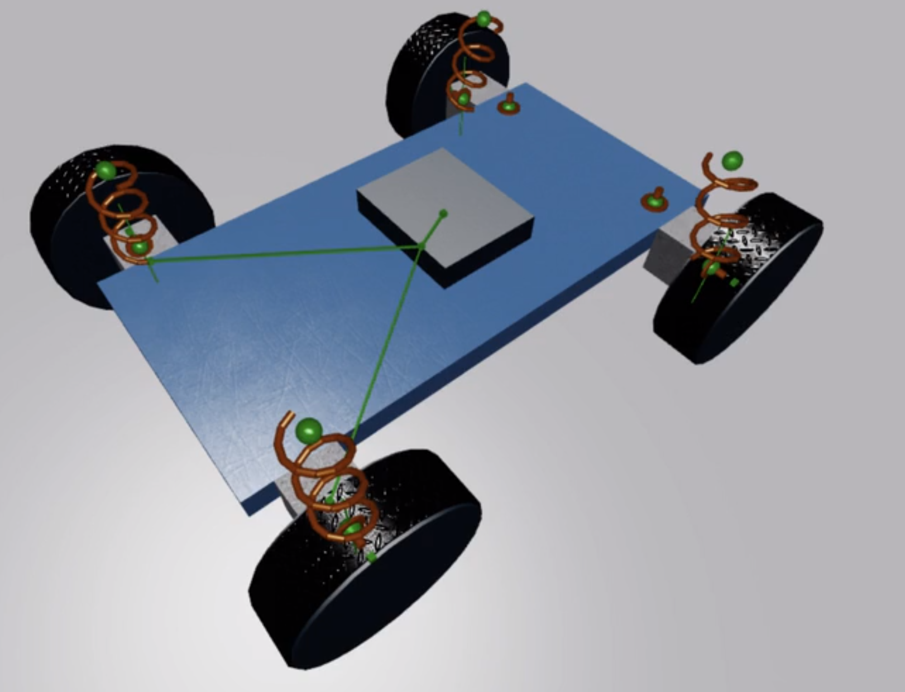
BUILDING A CAR
Game Development Process
IDEATE: We want to build a Racing Car in Roblox.
What should a car be able to do?
What are some cool features we could add?
DESIGN:
What parts can you see?
What constraints?
Where do we start?
TESTING:
When should we test?

Slide 9
CLASS PROJECT

